Slide 1
LEVIES AND CHARGES
Chapter 11
Foundations of Taxation Law

Slide 2
Introduction
In addition to being required to pay income tax, taxpayers may also be required to make other payments to the ATO, including:
  Medicare levy
  Medicare levy surcharge
  HELP repayments
[¶11.1]
Foundations of Taxation Law
Foundations of Taxation Law
© CCH Australia Limited

Slide 3
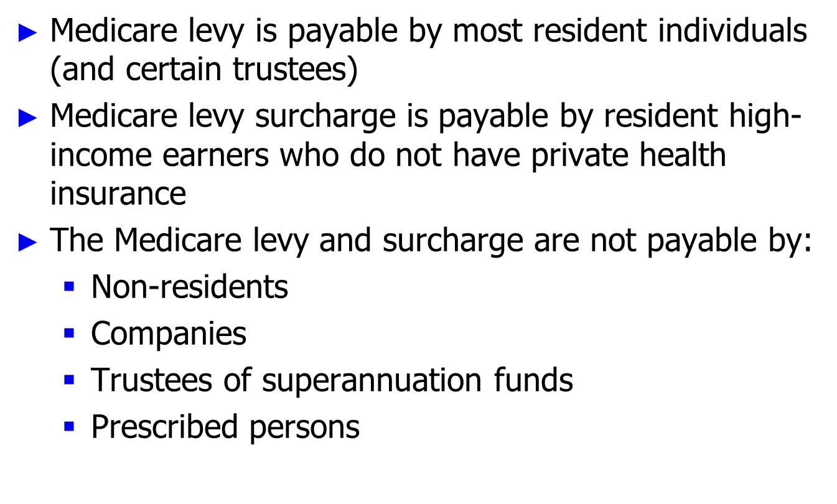
Medicare levy and surcharge
[¶11.2](a)
Foundations of Taxation Law
Foundations of Taxation Law
© CCH Australia Limited

Slide 4
Medicare levy
Medicare levy is imposed on a person’s taxable income
Imposed at a rate of 1.5%, subject to:
  Threshold rules – the Medicare levy is not payable where the taxpayer’s taxable income is below certain threshold amounts
  Phase-in rules – the Medicare levy is phased in where the taxpayer’s taxable income is above the threshold amount, but below the “phase-in limit”
[¶11.2](b)
Foundations of Taxation Law
Foundations of Taxation Law
© CCH Australia Limited

Slide 5
Medicare levy surcharge
Medicare levy surcharge is imposed on a person’s “income for surcharge purposes”
Income for surcharge
purposes
Taxable
income
Reportable
fringe benefits
total
Reportable
superannuation
contributions
Total net
investment
loss
Less the amount of a
superannuation benefit eligible for
a tax offset under s 301-20(2) ITAA97
[¶11.2](c)
Foundations of Taxation Law
Foundations of Taxation Law
© CCH Australia Limited

Slide 6
Medicare levy surcharge (cont)
Imposed at the rate of 1% for any period during an income year that the person is not covered by private health insurance
Surcharge applies if “income for surcharge purposes” exceeds:
  $77,000 for singles (2010/11)
  $154,000 for families (2010/11)
[¶11.2](d)
Foundations of Taxation Law
Foundations of Taxation Law
© CCH Australia Limited

Slide 7
The Higher Education Loans Program (HELP)
HELP consists of:
  HECS-HELP (for eligible Commonwealth supported students)
  FEE-HELP (for eligible fee-paying students), and
  OS-HELP (for eligible Commonwealth supported students studying overseas during their courses)
Higher education fees can be paid:
  Upfront (discount applies if the payment is > $500), and/or
  By taking out a HELP loan
[¶11.3](a)
Foundations of Taxation Law
Foundations of Taxation Law
© CCH Australia Limited

Slide 8
Repayment of HELP debts
HELP debts:
  Must be repaid under the tax system where “repayment income” exceeds prescribed annual threshold amount
  May be voluntarily paid off at any time (10% bonus credited against remaining HELP debt if the payment is > $500)
The rate of repayment varies depending on the level of the person’s “repayment income”
[¶11.3](b)
Foundations of Taxation Law
Foundations of Taxation Law
© CCH Australia Limited

Slide 9
Repayment income
Repayment income
Taxable
income
Net
investment
loss
Reportable
fringe
benefits total
Exempt
foreign
income
Reportable
superannuation
contributions
[¶11.3](c)
Foundations of Taxation Law
Foundations of Taxation Law
© CCH Australia Limited

Slide 10
HELP repayment thresholds and rates 2010/11
HELP repayment income | Repayment rate
Below $44,912 | Nil
$44,912 – $50,028 | 4%
$50,029 – $55,143 | 4.5%
$55,144 – $58,041 | 5%
$58,042 – $62,390 | 5.5%
$62,391 – $67,570 | 6%
$67,571 – $71,126 | 6.5%
$71,127 – $78,273 | 7%
$78,274 – $83,407 | 7.5%
$83,408 and above | 8%
[¶11.3](d)
Foundations of Taxation Law
Foundations of Taxation Law
© CCH Australia Limited

